Slide 1
Outline
Date | Day | Time | Topic
August 21 | Monday | 3-4 pm EST | Understanding the Patient
September 5 | Tuesday | 3-4 pm EST | Basics of Motivational Interviewing
September 12 | Tuesday | 3-4 pm EST | Community Reinforcement Approach and CBT
September 18 | Monday | 3-4 pm EST | Dialectical Behaviour Therapy
September 25 | Monday | 3-4 pm EST | Seeking Safety and trauma treatment
October 2 | Monday | 3-4 pm EST | Contingency Management
October 10th | Tuesday | 3-4 pm EST | Community Reinforcement Approach and Family Training
October 16 | Monday | 3-4 pm EST | Putting it all together – building competency in practice

Slide 2
Trauma informed care vs PTSD treatment
Wiplove Lamba, MD, FRCPC, Dip ABAM, ISAM (C),DABPN,
ABPM (Addiction Medicine)
Physician Lead, Substance Use Service, Sinai Health System, Toronto
Wiplove.lamba@sinaihealth.ca

Slide 3
SUBSTANCE USE DISORDERS
Core Symptoms
Comorbid PTSD
Comorbid BPD
MI
Motivation
Stages of Change
Seeking Safety
Dialectical Behaviour Therapy
CBT
Relapse Prevention
Cognitive Processing Therapy
Contingency Management
Community Reinforcement
12-Step
Community Reinforcement and Family Training
(CRAFT)
Courtesy: Ketan Vegda, MD

Slide 4
OUTLINE
CASE
Trauma
Trauma Informed Care
How to do Seeking safety
OUD, complex PTSD, PTSD
Next steps
Notes:
Add an outline – give learner’s a birds eye view of your talk and how it will unfold

Slide 5
CASE
Think of a challenging patient who may have had trauma and substance use
The interaction does not have to be for treatment of either condition
Think about what were you going through in the encounter
Think about what the patient was going through in the encounter

Slide 6
CASE
As you hear the content today, I want you to wonder if and how the philosophy discussed today could help or hurt your patients.
Think about a comment/question that you would like to share during the interaction time?

Slide 8
Story time
40-50 yo female, clinic intoxicated
med detox
Residential
Jean tweed plus/minus house of sophrasene
30-40 male
On OUD x 10 plus years
Ptsd and bpd
Addiction groups, plus DBT plus PE
PE – patient picked which trauma to start with

Slide 9
OUTLINE
CASE
Trauma
Trauma Informed Care
How to do Seeking safety
OUD, complex PTSD, PTSD
Next steps
Notes:
Add an outline – give learner’s a birds eye view of your talk and how it will unfold

Slide 10
PTSD DSM V
CRITERION
A: stressor
B: intrusion symptoms
C: avoidance
D: negative alterations in cognitions and mood
E: alterations in arousal and reactivity
F: duration
G: functional significance
H: exclusion
Specify if: With dissociative symptoms.
Specify if: With delayed expression.
Notes:
Criterion A: stressor
The person was exposed to: death, threatened death, actual or threatened serious injury, or actual or threatened sexual violence, as follows: (one required)
Direct exposure.
Witnessing, in person.
Indirectly, by learning that a close relative or close friend was exposed to trauma. If the event involved actual or threatened death, it must have been violent or accidental.
Repeated or extreme indirect exposure to aversive details of the event(s), usually in the course of professional duties (e.g., first responders, collecting body parts; professionals repeatedly exposed to details of child abuse). This does not include indirect non-professional exposure through electronic media, television, movies, or pictures.
Criterion B: intrusion symptoms
The traumatic event is persistently re-experienced in the following way(s): (one required)
Recurrent, involuntary, and intrusive memories. Note: Children older than six may express this symptom in repetitive play.
Traumatic nightmares. Note: Children may have frightening dreams without content related to the trauma(s).
Dissociative reactions (e.g., flashbacks) which may occur on a continuum from brief episodes to complete loss of consciousness. Note: Children may reenact the event in play.
Intense or prolonged distress after exposure to traumatic reminders.
Marked physiologic reactivity after exposure to trauma-related stimuli.
Criterion C: avoidance
Persistent effortful avoidance of distressing trauma-related stimuli after the event: (one required)
Trauma-related thoughts or feelings.
Trauma-related external reminders (e.g., people, places, conversations, activities, objects, or situations).
Criterion D: negative alterations in cognitions and mood
Negative alterations in cognitions and mood that began or worsened after the traumatic event: (two required)
Inability to recall key features of the traumatic event (usually dissociative amnesia; not due to head injury, alcohol, or drugs).
Persistent (and often distorted) negative beliefs and expectations about oneself or the world (e.g., "I am bad," "The world is completely dangerous").
Persistent distorted blame of self or others for causing the traumatic event or for resulting consequences.
Persistent negative trauma-related emotions (e.g., fear, horror, anger, guilt, or shame).
Markedly diminished interest in (pre-traumatic) significant activities.
Feeling alienated from others (e.g., detachment or estrangement).
Constricted affect: persistent inability to experience positive emotions.
Criterion E: alterations in arousal and reactivity
Trauma-related alterations in arousal and reactivity that began or worsened after the traumatic event: (two required)
Irritable or aggressive behavior
Self-destructive or reckless behavior
Hypervigilance
Exaggerated startle response
Problems in concentration
Sleep disturbance
Criterion F: duration
Persistence of symptoms (in Criteria B, C, D, and E) for more than one month.
Criterion G: functional significance
Significant symptom-related distress or functional impairment (e.g., social, occupational).
Criterion H: exclusion
Disturbance is not due to medication, substance use, or other illness.
Specify if: With dissociative symptoms.
In addition to meeting criteria for diagnosis, an individual experiences high levels of either of the following in reaction to trauma-related stimuli:
Depersonalization: experience of being an outside observer of or detached from oneself (e.g., feeling as if "this is not happening to me" or one were in a dream).
Derealization: experience of unreality, distance, or distortion (e.g., "things are not real").
Specify if: With delayed expression.
Full diagnosis is not met until at least six months after the trauma(s), although onset of symptoms may occur immediately.

Slide 11
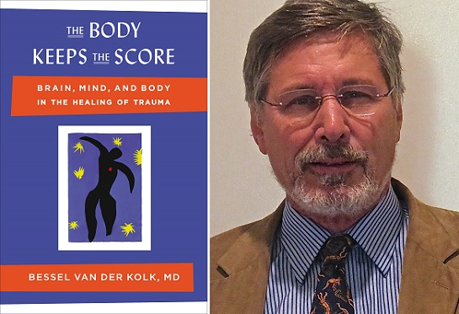
DEVELOPMENTAL TRAUMA DISORDER

Slide 12
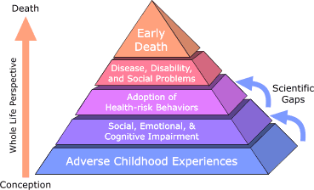
ADVERSE CHILDHOOD EXPERIENCES
Nadine Burke Harris Pediatrician– TED Talk on ACE STUDY
Figure from Centre for Disease Control

Slide 13
OUTLINE
CASE
Trauma
Trauma Informed Care
How to do Seeking safety
OUD, complex PTSD, PTSD
Next steps
Notes:
Add an outline – give learner’s a birds eye view of your talk and how it will unfold

Slide 14
TRAUMA-INFORMED CARE
Shift in basic question from
What’s wrong with you
TO
What’s happened to you or how does that continue to live on in your life how you function in your day
We need a greater sensitivity and deeper understanding of the patient experience
Vicky Kelly – Ted X talk –The paradox of Trauma informed Care

Slide 15
TRAUMA-INFORMED CARE
Normal development
In good human development – you can reliably perceive the world in an objective way and plan for the future in a flexible way
Recognize feelings and tolerate long enough to learn from them and develop a stable sense of identity and self efficacy.
Form trusting relationships and rely on them for support
All of these depend on a strong connection from the emotional to the logical brain
Vicky Kelly – Ted X talk –The paradox of Trauma informed Care

Slide 16
TRAUMA-INFORMED CARE
Trauma has 3 impacts
EMOTIONAL BRAIN BECOMES A SURVIVAL BRAIN
ALARM SYSTEM IS DISTORTED
INABILITY TO APPRAISE THE PRESENT AND LEARN FROM EXPERIENCE
Vicky Kelly – Ted X talk –The paradox of Trauma informed Care

Slide 17
TRAUMA-INFORMED CARE
Think about the cases you talked about earlier in the talk.
Do these difficult to engage patients need to fully work through their trauma before we can help them?
Can we help patients make use of their “calm” brain so they can get the help they need?

Slide 18
OUTLINE
Case and comments/questions
Trauma
Trauma Informed Care
How to do Seeking safety
Self Care

Slide 19
SEEKING SAFETY
www.seekingsafety.org
A present-focused model to help clients attain safety from PTSD and substance use
25 topics in any order (interpersonal, cognitive, behavioural, other)
Flexible
Key principles are safety, integrated treatment, focus on ideals, 4 content areas, attention to clinican processes.

Slide 20
SEEKING SAFETY
Trauma details are not a part of group therapy
Identify meaning of substance use in context of PTSD
Optimistic
Help clients obtain more treatment
Harm reduction model or abstinence
12 step encouraged, not required
Empower clients
Make treatment engaging
Emphasize core concepts

Slide 21
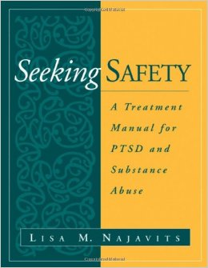
SEEKING SAFETY SESSION
PREPARATION
Get book
Read 1-2 chapters
Pick topic
Print handouts
Coach patient/client
Follow format

Slide 22
SEEKING SAFETY
Core topics include
Safety
Respect yourself
Use coping-not substances – to escape the pain
Make the present and future bettern than the past
Learn to trust
Take good care of your body
Never, never, never, never, never, never give up

Slide 23
SEEKING SAFETY SESSION
Format
Check in
Since your last session
How are you feeling
What good coping have you done?
Any substance use or other unsafe behaviour
Did you complete your commitment?
Community resource update

Slide 24
SEEKING SAFETY SESSION
Format
Quote
Eg. “No feeling is final”
Ask the group “what’s the main point”
Link the quote to the topic of the day, have them skim the patient booklet and go over concept and continue discussion
Opportunities for role play, to link to check in and to practice skills

Slide 25
SEEKING SAFETY SESSION
Grounding
Cover 3 methods mental, physical, soothing
spend 10 min doing an exercise and debriefing – all guiding questions are in the text
Trouble shoot the upcoming week and items to focus on
Works better as the focus is on the external world.

Slide 26
SEEKING SAFETY SESSION
Check Out
Name one thing you got out of today’s session (and any problems with the session)
What is your new commitment?
What community resource will you call?

Slide 27
OUTLINE
CASE
Trauma
Trauma Informed Care
How to do Seeking safety
OUD, complex PTSD, PTSD
Next steps
Notes:
Add an outline – give learner’s a birds eye view of your talk and how it will unfold

Slide 28
PTSD and Opioid Use
SUD – 26-52% have PTSD
OUD – 41% lifetime and 33% current PTSD
OUD Rx – saves lives
OUD plus PTSD –poorer retention, outcomes, but OAT still reduces opioid use
Recommend integrated approach
Multiple barriers
Dahlby L, Kerr T. PTSD and opioid use: implications for intervention and policy. Subst Abuse Treat Prev Policy. 2020 Mar 16;15(1):22. doi: 10.1186/s13011-020-00264-8. PMID: 32178693; PMCID: PMC7077145.

Slide 29
Mood/anxiety treatment in OUD
OAT treatment has a much bigger impact than Therapy/meds; Once stable on OAT, you can get symptoms improvement
Hassan AN, Howe AS, Samokhvalov AV, Le Foll B, George TP. Management of mood and anxiety disorders in patients receiving opioid agonist therapy: Review and meta-analysis. Am J Addict. 2017 Sep;26(6):551-563. doi: 10.1111/ajad.12581. Epub 2017 Jul 4. PMID: 28675762.
SAMHSA suggest treating both OUD and PTSD
Substance Abuse and Mental Health Services Administration, Pharmacologic Guidelines for Treating Individuals with Post-Traumatic Stress Disorder and Co-Occurring Opioid Use Disorders. HHS Publication No. SMA-12-4688, Rockville, MD: Substance Abuse and Mental Health Services Administration, 2012.

Slide 30
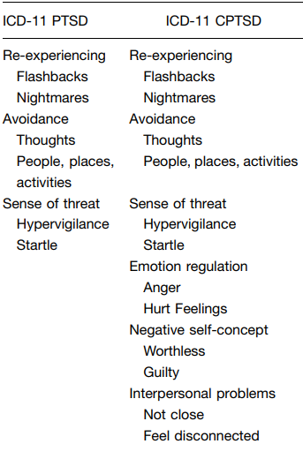
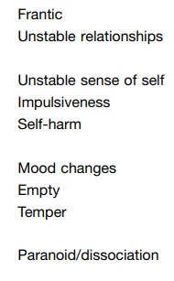
cPTSD
Marylène Cloitre, Donn W. Garvert, Brandon Weiss, Eve B. Carlson & Richard A. Bryant (2014) Distinguishing PTSD, Complex PTSD, and Borderline Personality Disorder: A latent class analysis, European Journal of Psychotraumatology, 5:1, DOI: 10.3402/ejpt.v5.25097

Slide 31
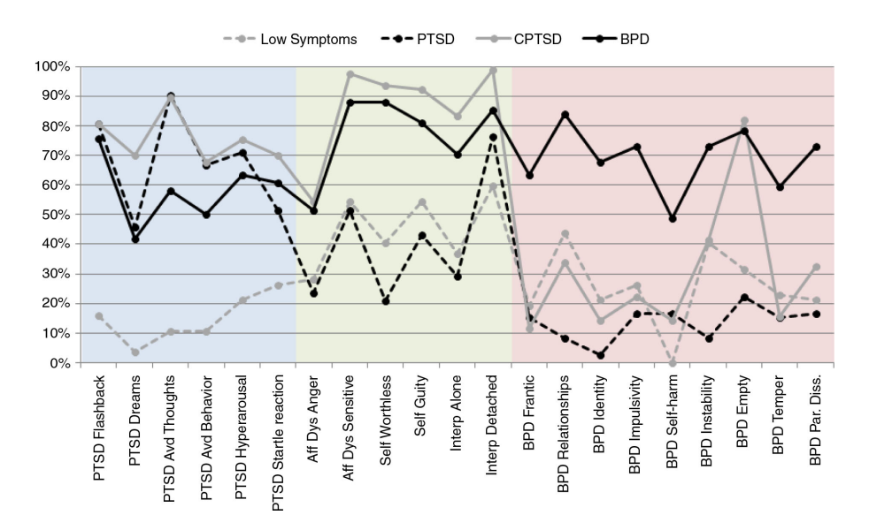
cPTSD

Slide 32
cPTSD
cPTSD –higher mood change and unstable relationships than PTSD group.
PTSD – has PTSD but low levels of self organization
BPD –frantic about abandonment, unstable relationships, unstable sense of self and impulsiveness BUT NOT EMPTINESS
BPD also had more self harm
Marylène Cloitre, Donn W. Garvert, Brandon Weiss, Eve B. Carlson & Richard A. Bryant (2014) Distinguishing PTSD, Complex PTSD, and Borderline Personality Disorder: A latent class analysis, European Journal of Psychotraumatology, 5:1, DOI: 10.3402/ejpt.v5.25097

Slide 33
cPTSD
Excellent review article
prevalence and comorbidity;
clinical phenomenology;
traumatic antecedents;
psychobiology;
emotion dysregulation;
dissociation; and
empirically supported approaches to clinical assessment and psychotherapeutic treatment

Slide 34
What do you do?
I will screen for PTSD (PCPTSD screen plsu PCL-5) and BPD (Maclean BPD screen, plus BSL 23)
Paper suggests
DBT plus PTSD treatment (PE/CT/?)EMDR

Slide 35
STAGE WISE APPROACH
Stage wise approach to trauma treatment
Judith Herman
Stage 1
Stage 2
Stage 3

Slide 36
PTSD SYMPTOMS
Further investigation of trauma symptoms is warranted or refer to a specialized assessment and treatment program
Patients who screen positive for PTSD should be explicitly screened for suicidal ideation, depression and substance abuse
Symptom overlap with Borderline Personality Disorder, which can sometimes become the focus rather than treating trauma symptoms
Intrusions, Arousal, Autobiographical Memory

Slide 37
PTSD
Emdr
PE
CPT/CBT

Slide 38
COGNITIVE PROCESSING THERAPY
Cognitive processing therapy
2 day training
Posttraumatic Stress Disorder Checklist (PCL-5)
http://traumadissociation.com/pcl5-ptsd
Scoring: https://www.ptsd.va.gov/professional/assessment/adult-sr/ptsd-checklist.asp
What are the stuck points?
E.g. black-and-white; all-or-nothing; if-then statements; concise; thoughts behind moral statements or the Golden rule; not always “I” statements

Slide 39
AVOIDANCE OF EXTERNAL REMINDERS
Aggression
Self-harm behaviours
Substance abuse
Bingeing
Cognitive avoidance
Behavioural avoidance
Dissociation
Emotional suppressioin
Social withdrawal
Behavioural inhibition
Somatic complaints

Slide 40
RESOURCE
Cognitive Processing Therapy for PTSD: A Comprehensive Manual
By Patricia A. Resick, Candice M. Monson, and Kathleen M. Chard
https://www.guilford.com/books/Cognitive-Processing-Therapy-for-PTSD/Resick-Monson-Chard/9781462528646/reviews
Notes:
Add an outline – give learner’s a birds eye view of your talk and how it will unfold

Slide 41
SUBSTANCE USE DISORDERS
Core Symptoms
Comorbid PTSD
Comorbid BPD
MI
Motivation
Stages of Change
Seeking Safety
Dialectical Behaviour Therapy
CBT
Relapse Prevention
Cognitive Processing Therapy
Contingency Management
Community Reinforcement
12-Step
Community Reinforcement and Family Training
(CRAFT)
Courtesy: Ketan Vegda, MD

Slide 42
Summary
Trauma,
Trauma informed care/Seeking Safety
DTD/cPTSD, PTSD, BPD
PTSD treatment
Use OAT
Wiplove.lamba@sinaihealth.ca

