Slide 1
Outline
CM concept and principles
CM key elements and steps
Examples of effective CM
Resources
Petry, 2012. “Contingency Management for Substance Use Treatment: A guide
To implementing this evidence based practice
Notes:
Add an outline – give learner’s a birds eye view of your talk and how it will unfold

Slide 2
Azrin
? Relevant story

Slide 3
Cm concepts and principles
Behaviour
A → B→ C
Antecedent, behaviour, consequence (+ then -)
Trigger, Behaviour, Reward
Social context
Notes:
Used in non substance using populations, residential substance use

Slide 4
Cm
For REINFORCEMENT - Need 3 key principles
Award appropriate magnitudes of tangible reinforcement
Provide reinforcement every time behaviour is observed
Appropriate timing (avoid long delay)
Notes:
Add an outline – give learner’s a birds eye view of your talk and how it will unfold

Slide 5
behaviour
Positive reinforcement
Negative reinforcement
Withhold reward
Clinical settings
Behaviour therapies
Token economy
Tend to work more in closed environments
Outpatient settings
Cheering and clapping in AA, coffee and food

Slide 6
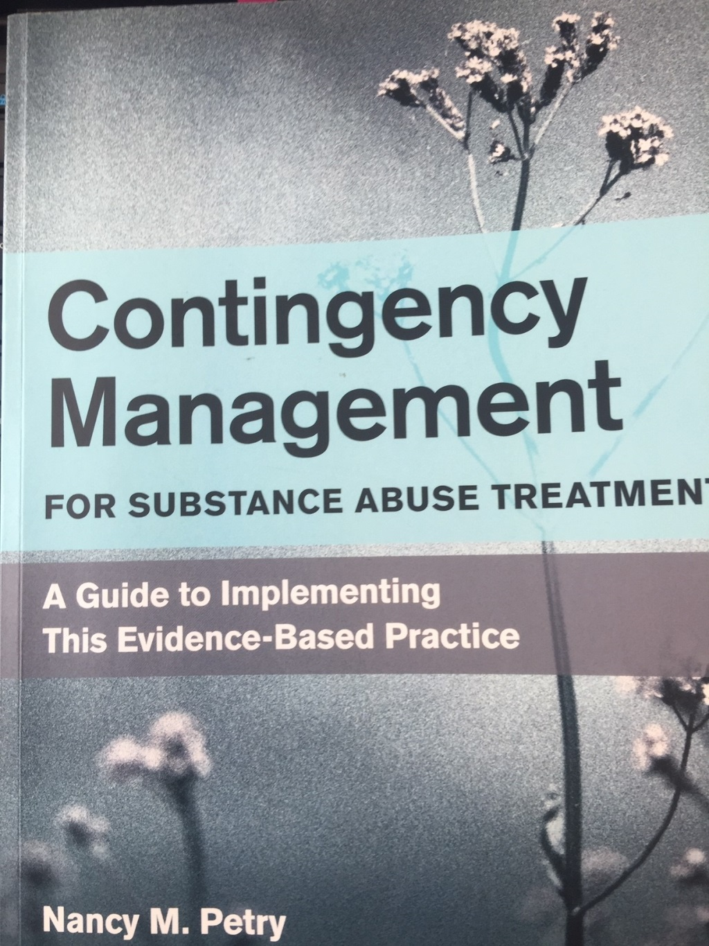

Slide 7
cm
The application of tangible positive reinforcers to change behaviour, and specifically substance using behaviour
Notes:
Add an outline – give learner’s a birds eye view of your talk and how it will unfold

Slide 8
cm
3 key basic principles
Frequently monitor the behaviour you are trying to change
Provide tangible, immediate positive reinforcers each time that the behaviour occurs
When the behaviour does not occur, withhold the positive reinforcers

Slide 9
Where/how has it been done?
Methadone clinics in 60s in US – take home dosing guidelines (challenges)
Voucher System
Prizes CM – individual abstinence
Name in the hat Prize CM – group attendance

Slide 10
Voucher system
Stephen Higgins, University of Vermont
Voucher based procedure integrating token economy, applied to outpatient substance
Points worth money for negative urine
Can deposit vouchers to clinic to get items (coffee to clothes to ipod)
Vouchers increase in value with each good result
Eg. Total of 1000 dollars if abstinance is maintained over 12 weeks

Slide 11
Voucher system
1st compared voucher CM plus CRA to 12 step. (Hunt and Azrin, 1973 )
Was not just office based (home visits)
First 13 patient CRA plus CM, next 15 just 12SF
85% of CM vs 33% of 12 step stayed in treatment
75% of those in CM stayed abstinant vs 0% in 12 SF

Slide 12
Voucher system
CM plus CRA had better results than CRA alone (Higgins 1994)
Contingent delivery works better (Silverman etal 1996)
Many other positive studies in cocaine, opioids, nicotine, cannabis pages 22-23 in CM reference book

Slide 13
Voucher system
Expensive
Hard to implement
Works better in closed environment

Slide 14
Prize based cm
Chance to win prize based on negative UDS or breathalyzer

Slide 15
Name-in the hat Prize CM
Dr. Vegda and Dr. T. Hauck

Slide 16
Cm protocol steps
Design a protocol
Narrow down the behaviour to reinforce
Choose a patient population
Design and monitor reinforcement schedule
Select re-inforcers

Slide 17
Design a reinforcement schedule
Priming
Immediacy
Escalating and reset features
Magnitude
Monitoring

Slide 18
COST
Outcome
urine drug tests
Cost of prizes
Administrative estimates
Raising funds – section in guidebook

Slide 19
Getting started
CM related items include prize bowl, stationary, lockable prize cabinet, urine testing supplies
Determine initial prizes
Keeping track
documentation

Slide 20
Prize in the hat
Escalating slips for consecutive attendance
Do at beginning of session (5-10 min)
Process for excused absence
Draws
Book has each session laid out like psychotherapy

Slide 21
Adherence
Are you following the protocol?

Slide 22
Discussion
What have you seen done in your work environment?
Was it helpful or not?
Comments or suggestions for the group on what would work?

