Slide 1
CBT/CRA
Wip Lamba MD, FRCPC, DABPN, Dip ABAM

Slide 2
“If you treat an individual...
as if he were what he ought to be and could be,
he will become
what he ought to be and could be”
Johann Wolfgang von Goethe (1749-1832)

Slide 3
SUBSTANCE USE DISORDERS
Core Symptoms
Comorbid PTSD
Comorbid BPD
MI
Motivation
Stages of Change
Seeking Safety
Dialectical Behaviour Therapy
CBT
Relapse Prevention
Cognitive Processing Therapy
Contingency Management
Community Reinforcement
12-Step
Community Reinforcement and Family Training
(CRAFT)
Courtesy: Ketan Vegda, MD

Slide 4
CBT
CBT for SUDs encompasses a variety of interventions that emphasize different targets. Below we review individual and group treatments including motivational interventions, contingency management strategies, and Relapse Prevention and related interventions with a focus on functional analysis.

Slide 5
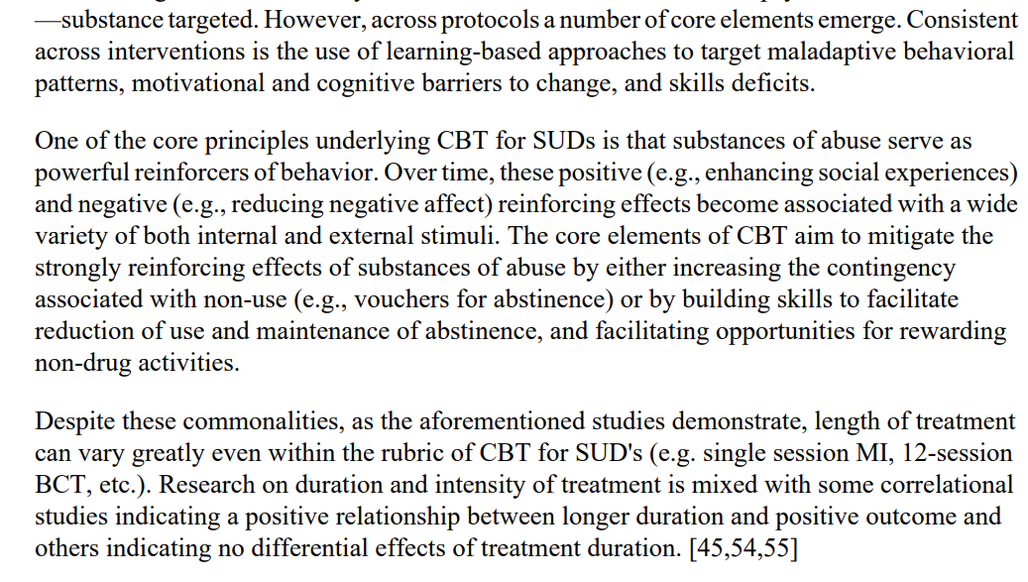
CBT

Slide 6
Community Reinforcement Approach
Nathan Azrin http://www.nathanazrin.com/
Bob Meyers https://robertjmeyersphd.com/cra.html
https://www.ccsa.ca/sites/default/files/2019-04/CCSA-Community-Reinforcement-Approach-Summary-2017-en.pdf

Slide 7
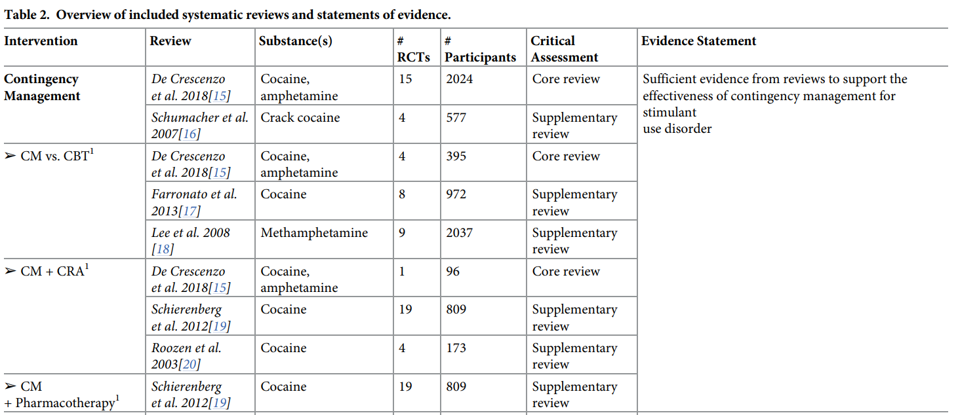
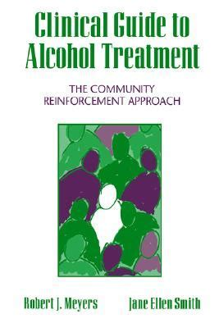
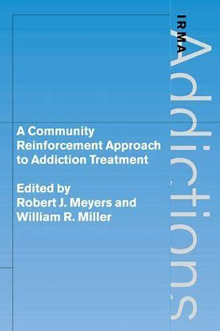
WHY CRA?
Citation: Ronsley C, Nolan S, Knight R, Hayashi K, Klimas J, Walley A, et al. (2020) Treatment of stimulant use disorder: A systematic review of reviews. PLoS ONE 15(6): e0234809. https://doi. org/10.1371/journal.pone.0234809

Slide 8
Thinking behaviourally
DRIVE
Antecedent 🡪 Behaviour 🡪 Consequence

Slide 9
Thinking behaviourally
Functional Analysis – unhealthy behaviour
External triggers
who, where, when
Internal triggers
thinking, feeling (emotionally, physically)
Behaviours
What, how much, how long
Short term positive consequences
What do you like about drinking (who, where, when)
What is pleasant about drinking (thoughts, emotions, physical)
Long term negative consequences
Interpersonal, physical, emotional, legal, job, financial, other

Slide 10
CRA - 8 Procedures and Descriptions
1. Functional Analysis of Substance Abuse*
2. Sobriety Sampling Strategy*
3. CRA Treatment Plan – REBT & CBT*
4. Personal Relapse Prevention Strategy*
5. Behaviour Skills Training*
6. Job Skills Training
7. Social and Recreational Counseling
8. Relationship Counseling – Family, Friends, Partners

Slide 11
Community Reinforcement Approach (CRA)

Slide 12
CRA
Goal of CRA
……..”to rearrange the vocational, family, and social reinforcers of the alcoholic such that time-out from these reinforcers would occur if he began to drink” (Hunt & Azrin, 1973)

Slide 13
CRA
Build Rapport
Time Limited
Client Focused
Positive Reinforcement
Functional Analysis of unhealthy behaviour
Functional Analysis of healthy behaviour

Slide 14
CRA
Functional Analysis – unhealthy behaviour
External triggers
who, where, when
Internal triggers
thinking, feeling (emotionally, physically)
Behaviours
What, how much, how long
Short term positive consequences
What do you like about drinking (who, where, when)
What is pleasant about drinking (thoughts, emotions, physical)
Long term negative consequences
Interpersonal, physical, emotional, legal, job, financial, other

Slide 15
CRA
Functional Analysis – healthy behaviour
Ideally Remember to:
Use a pro-social behavior that is occurring occasionally already
Use a behavior that is both healthy and FUN
Help identify & address roadblocks before they happen

Slide 16
CRA
Functional Analysis – healthy behaviour
Healthy Activity (what, how often, how long)
External triggers
With who, where, when
Internal Triggers
Thinking, feeling emotionally, feeling physically
Short term negative
What do you dislike about who, where, when?
Unpleasant thoughts, feeling emotional/physical
Long term positive
Interpersonal, physical, emotional, legal, job, financial, other

Slide 17
CRA
Functional Analysis – healthy behaviour
Try to pick a behaviour that is already occurring, healthy and fun – pro-social, give homework assignment

Slide 18
CRA
Sobriety Sampling – get to commit to specific goal, try 90 days
Medications (monitoring)
Happiness Scale and Goals of counseling

Slide 19
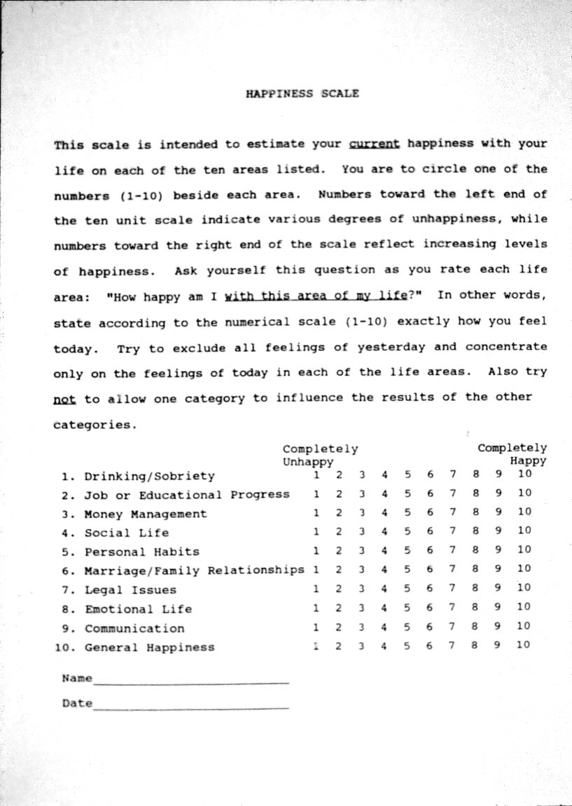

Slide 20
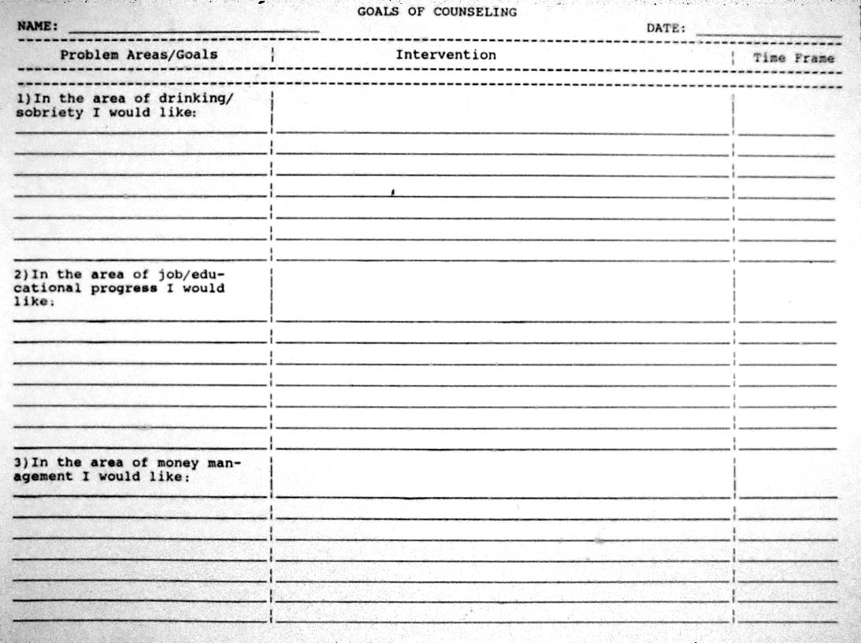
CRA
Goals of counselling
Each item on happiness scale
Goal, plan, timeline
How to set goals
Specific, Measurable, Attainable, Relevant, Timely

Slide 21
CRA
Skills Training
Communication skills/assertiveness training
Drink/drug refusal
Problem Solving
Job-finding skills
Anger management

Slide 22
CRA
Skills Training example - communication
Be brief, Be positive, Be specific and clear
Label your feeling: “I feel ___”
Offer an understanding statement
Accept partial responsibility
Offer to help

Slide 23
Functional Analysis of substance use
External Triggers
Internal Triggers
Pattern of use
Short term POSTIVES
Long term Negatives

Slide 24
Functional analysis of healthy behaviour
External triggers
Internal triggers
Rewarding healthy behaviour
Barriers
Positive consequences

Slide 25
What books?

Slide 26
How to become certified
https://www.robertjmeyersphd.com/
Attend 2 day training,
have recorded sessions
Modify approach based on feedback
Complete 9 protocols

Slide 27
SUBSTANCE USE DISORDERS
Core Symptoms
Comorbid PTSD
Comorbid BPD
MI
Motivation
Stages of Change
Seeking Safety
Dialectical Behaviour Therapy
CBT
Relapse Prevention
Cognitive Processing Therapy
Contingency Management
Community Reinforcement
12-Step
Community Reinforcement and Family Training
(CRAFT)
Courtesy: Ketan Vegda, MD

Slide 28
Thank you

