Slide 1
Putting it all together

Slide 2
OUTLINE
Sample case -
Understanding the patient
Engagement
CRA- Happiness Scale, Goals of Counselling, Function of Use
Distress Tolerance Skills – teach TIPS
Create Safety
Contingency Management
Involve Family Members
Create a road map

Slide 3
Case
25 ish year old male, single, NFA
Past history of psychosis with stimulants, and difficulties withanger.
Family history bipolar disorder anda afamily history of psycohis
No longer using stimulants regularly
No current psychosis
Occasional fentanyl/opioid smoking
ACES – adverse childhood experiences
Tends to prefer to be on their own, careful, pays attention to detail
Possible early trauma.
Difficulty in groups/group presentation, mistrust of others.
Help to reduce stimulants/opioids

Slide 4
Model of Addiction
Dimensional Model
Same as model of psychiatry
Disease Biology Eg. Bipolar, schizophrenia, delirium | Dimensions Eg. IQ, Personality inventory (NEO)
Behaviours Think – Antecedent → Behaviour → Consequence Shaped by DRIVE Consider functional analysis, behavior chain analysis Eg. Substance use, behaivoural disorders | Life Story Life experiences Eg. Grief, PTSD

Slide 5
MI
SPIRIT of MI
Contrasting Practice Exercise
Give Advice
Elicit
Practice

Slide 6
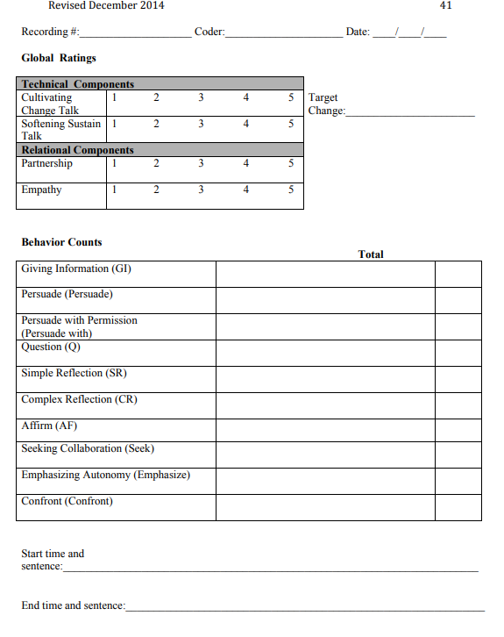
Practice
TRACK
Explore
Affirmations
Reflections
summarys

Slide 7
What books?

Slide 8
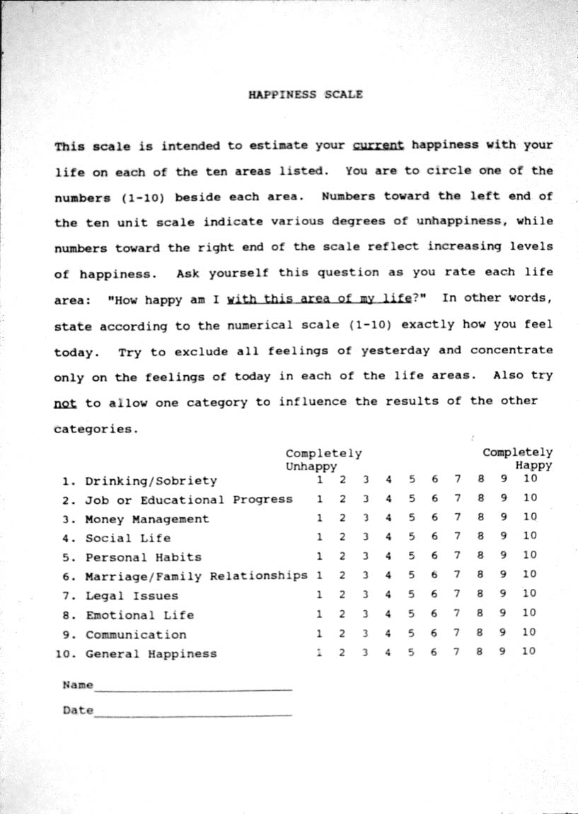

Slide 9
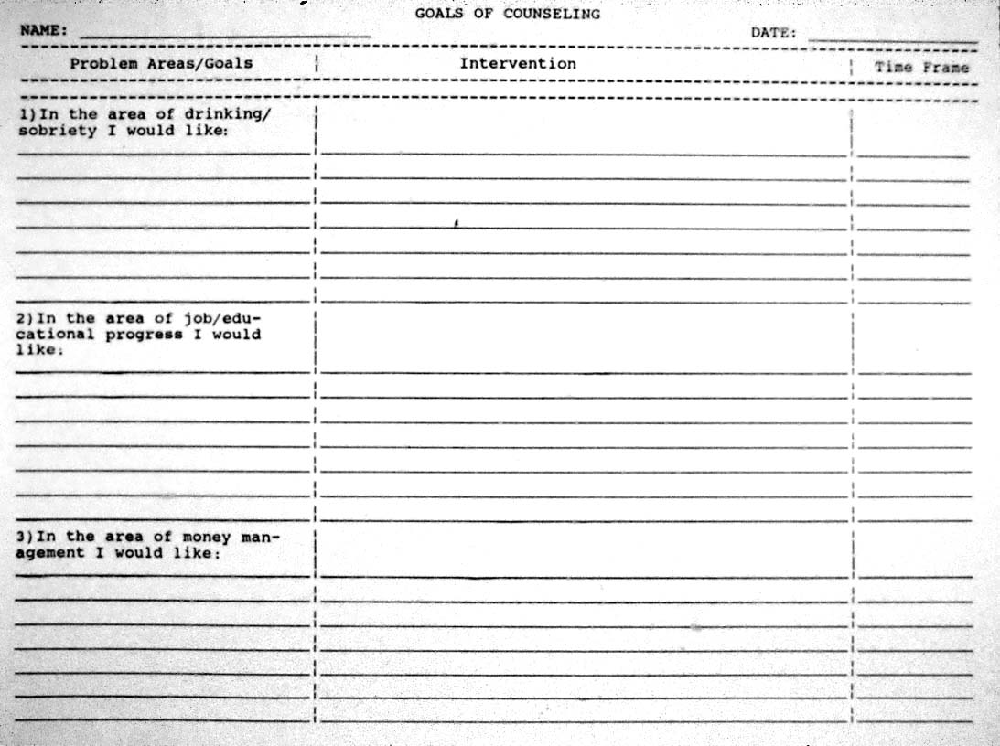
CRA
Goals of counselling
Each item on happiness scale
Goal, plan, timeline
How to set goals
Specific, Measurable, Attainable, Relevant, Timely

Slide 10
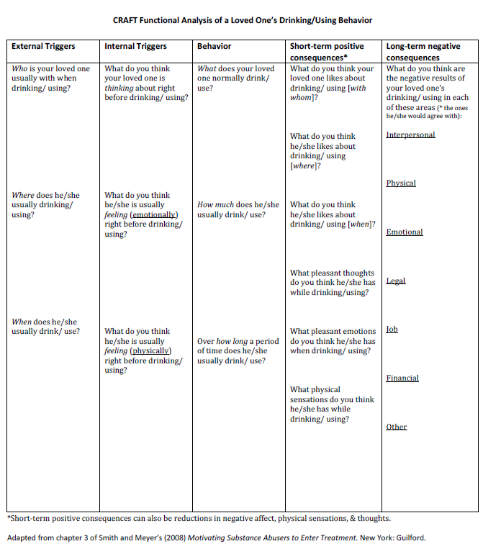

Slide 11
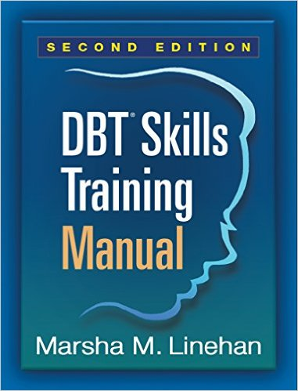
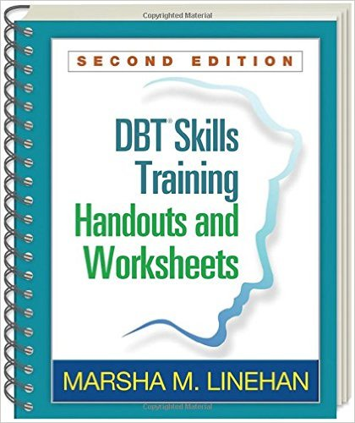
How did I learn DBT

Slide 15
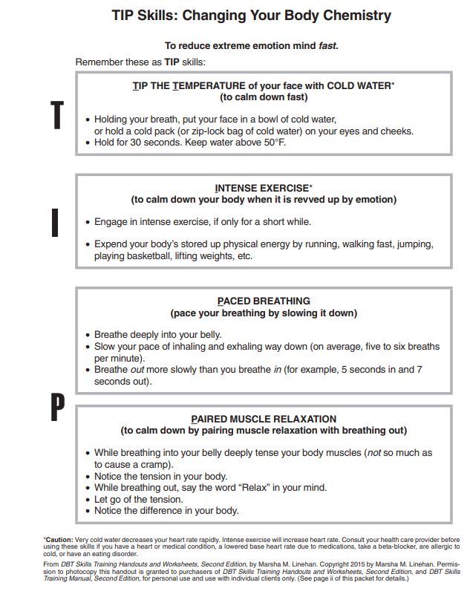

Slide 16
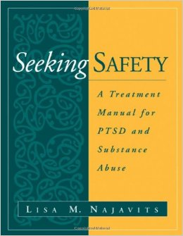
SEEKING SAFETY SESSION
PREPARATION
Get book
Read 1-2 chapters
Pick topic
Print handouts
Coach patient/client
Follow format

Slide 17
SEEKING SAFETY
Core topics include
Safety
Respect yourself
Use coping-not substances – to escape the pain
Make the present and future bettern than the past
Learn to trust
Take good care of your body
Never, never, never, never, never, never give up

Slide 18
SEEKING SAFETY SESSION
Format
Check in
Since your last session
How are you feeling
What good coping have you done?
Any substance use or other unsafe behaviour
Did you complete your commitment?
Community resource update

Slide 19
SEEKING SAFETY SESSION
Format
Quote
Eg. “No feeling is final”
Ask the group “what’s the main point”
Link the quote to the topic of the day, have them skim the patient booklet and go over concept and continue discussion
Opportunities for role play, to link to check in and to practice skills

Slide 20
SEEKING SAFETY SESSION
Grounding
Cover 3 methods mental, physical, soothing
spend 10 min doing an exercise and debriefing – all guiding questions are in the text
Trouble shoot the upcoming week and items to focus on
Works better as the focus is on the external world.

Slide 21
CRAFT – The 3 Goals for CSO’s
When a loved one is abusing substances and refusing to get help, CRAFT is designed to help families learn practical and effective ways to accomplish these three goals.
Help their loved one reduce alcohol and drug use
Move their loved one toward treatment
Simultaneously improve their own lives instead of focusing on the loved ones addiction.
Notes:
Add an outline – give learner’s a birds eye view of your talk and how it will unfold

Slide 22
CRAFT – 10 Messages for CSO’s
Research has shown that family members can successfully learn techniques to engage their substance abusing loved ones into treatment.
You are NOT alone.
You can catch more flies with honey than with vinegar.
You have as many tries as you want.
You can live a happier life whether your loved one (LO) becomes abstinent.
When you help yourself you help your family.
Neither you nor your loved one is crazy. All people have problems and substance misuse is just that – a problem. Problems can be solved.
The world is not black and white. Most problems vary in degree and difficulty.
Scientific studies have shown that labels “addict” or “alcoholic” create a stigma and are a major barrier when people are seeking help for substance abuse.
You have NOTHING to lose and EVERYTHING to gain by getting involved in the CRA process.
Notes:
Add an outline – give learner’s a birds eye view of your talk and how it will unfold

Slide 23
CRAFT Communication - 7 Steps for CSO’s
Be Brief
Be Positive
Refer to Specific Behaviours
Label your Feelings
Offer An Understanding Statement - For example, "I appreciate that you have these concerns [or] I understand that you really want to talk right now, and that this feels urgent… [or] I would love to be there for you."
Accept Partial Responsibility - This step "is really designed to decrease defensiveness on the part of your loved one. … It's not about accepting responsibility for things you are not responsible for. … [Rather, it's to] direct you towards the piece that you can own for yourself. … [For example, ] what you can take responsibility for are the ways that you communicate," etc.
Offer to Help.
Notes:
Add an outline – give learner’s a birds eye view of your talk and how it will unfold

Slide 24
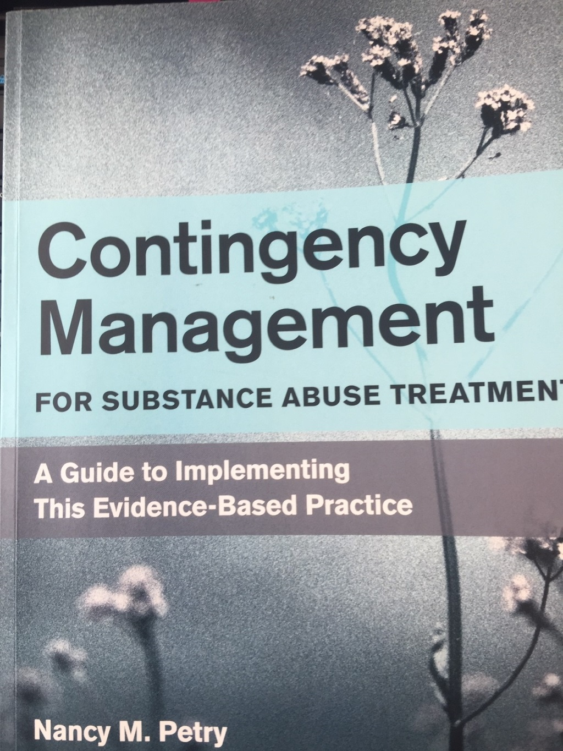

Slide 25
cm
The application of tangible positive reinforcers to change behaviour, and specifically substance using behaviour
Notes:
Add an outline – give learner’s a birds eye view of your talk and how it will unfold

Slide 26
cm
3 key basic principles
Frequently monitor the behaviour you are trying to change
Provide tangible, immediate positive reinforcers each time that the behaviour occurs
When the behaviour does not occur, withhold the positive reinforcers

Slide 27
Cm protocol steps
Design a protocol
Narrow down the behaviour to reinforce
Choose a patient population
Design and monitor reinforcement schedule
Select re-inforcers

Slide 28
Design a reinforcement schedule
Priming
Immediacy
Escalating and reset features
Magnitude
Monitoring

Slide 29
Back to the case

Slide 30
See you Wednesday!

