Slide 1
Outline
Date | Day | Time | Topic
August 21 | Monday | 3-4 pm EST | Understanding the Patient
September 5 | Tuesday | 3-4 pm EST | Basics of Motivational Interviewing
September 12 | Tuesday | 3-4 pm EST | Community Reinforcement Approach and CBT
September 18 | Monday | 3-4 pm EST | Dialectical Behaviour Therapy
September 25 | Monday | 3-4 pm EST | Seeking Safety and trauma treatment
October 2 | Monday | 3-4 pm EST | Contingency Management
October 9th | Monday | 3-4 pm EST | Community Reinforcement Approach and Family Training
October 16 | Monday | 3-4 pm EST | Putting it all together – building competency in practice

Slide 2
Quote
“If you treat an individual as he is, he will remain how he is. But if you treat him as if he were what he ought to be and could be, he will become what he ought to be and could be.”
― Johann Wolfgang von Goethe

Slide 3
Learning Objectives
Upon attending the session, the trainee will be able to:
  Be prepared to complete drills where they practice and give feedback to others on their motivational interviewing skills
  List and describe the key components of motivational interviewing in terms of spirit, skills and goals of treatment
  Ponder when, where and how these skills can be applied in clinical practice.

Slide 4

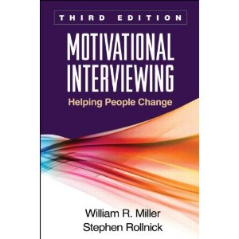
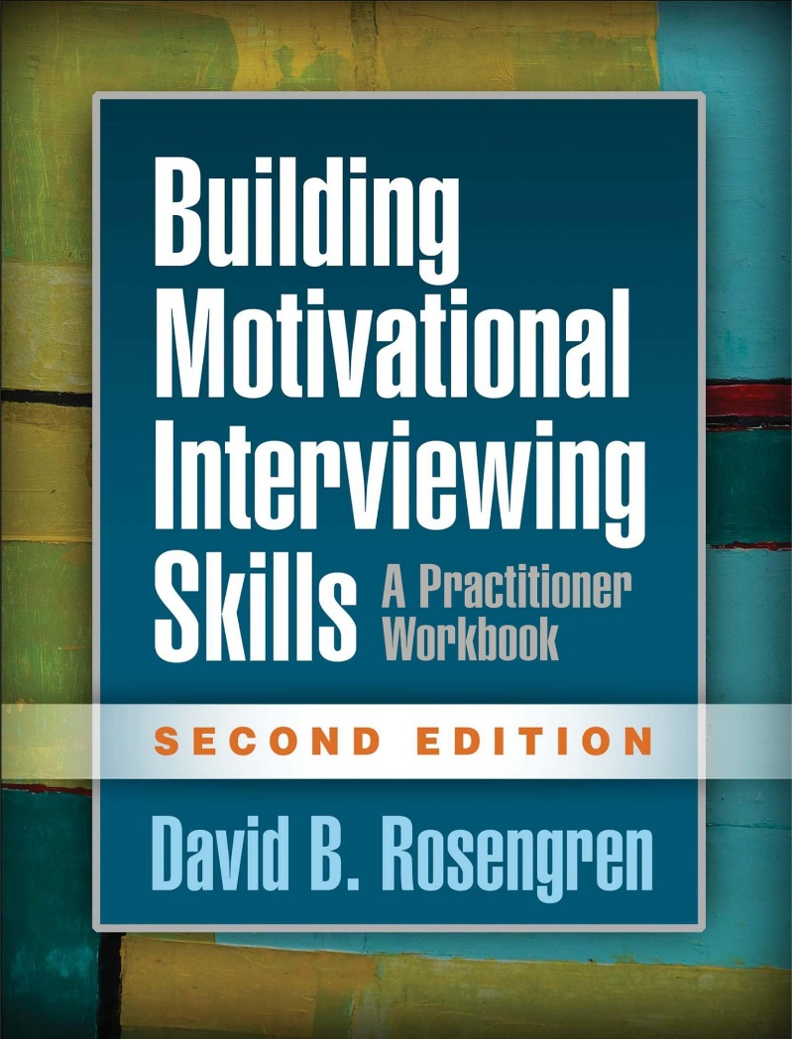
References

Slide 5
What is MI?
“Motivational interviewing is a collaborative, goal-oriented style of communication with particular attention to the language of change.
It is designed to strengthen personal motivation for, and commitment to a specific goal by eliciting and exploring the person’s own reasons for change within an atmosphere of acceptance and compassion.”
Notes:
Introduce self. Ask each person to say their name and their favorite self-care activity.

Slide 6
Advanced Motivational Interviewing
(thanks to Tim Guimond , Ketan Vegda, Carolynne Cooper, Tim Godden, etc. etc. etc
.
Notes:
Convey introduction with appropriate energy and presence. Confidence.

Slide 7
OUTLINE
To be adapted based on first few exercises
Importance/confidence rulers
Agenda Setting
Whirlwind Tour of MI Principles (including EPE)
Score the Trainer
BREAK
DARN CATS
Evaluate each other
What now?

Slide 8
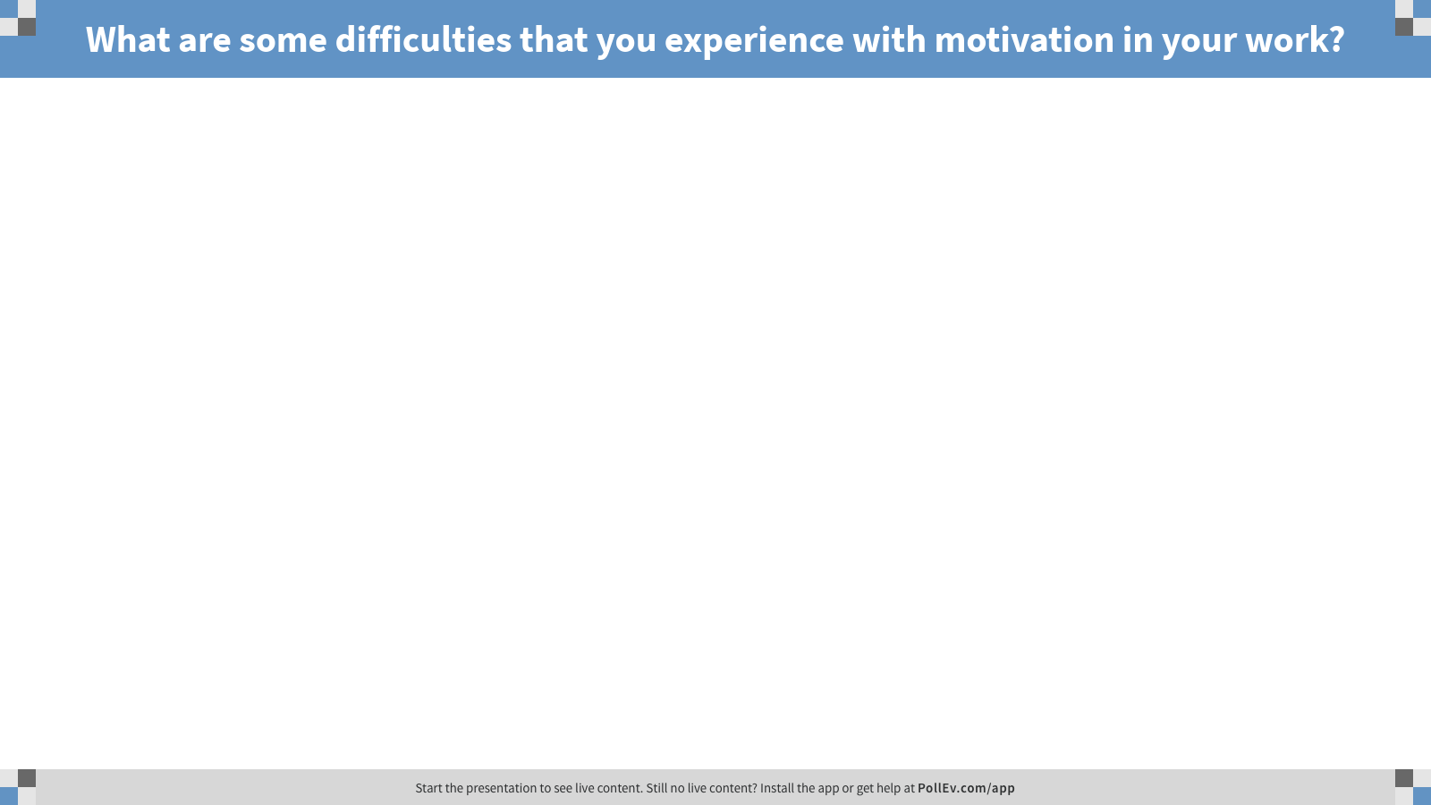
Notes:
Poll Title: What are some difficulties that you experience with motivation in your work?
https://www.polleverywhere.com/free_text_polls/j6UBJ7ezBHLioaJ

Slide 9

The Nature of Motivation
Discussion points:
Notes:
Facilitate the conversations- make sure each person has someone to talk with.

Slide 10
The Nature of Motivation
    Think of a change in your life that someone else thinks you should make, which you haven’t yet decided to act on.
Notes:
Let’s try to understand this experientially.

Slide 11
The Nature of Motivation
    Think of a change in your life that someone else thinks you should make, which you haven’t yet decided to act on.
    With a partner, discuss:
    The last time it came up, who started the conversation?
    How did the conversation unfold? What did they say? What did you say?
    How did you feel?
    Were you more or less motivated?

Slide 12
The Nature of Motivation
Discussion points:
Notes:
Facilitate the conversations- make sure each person has someone to talk with.

Slide 13
The Nature of Motivation
    Think of someone who was a helpful guide for you during a time of challenge or growth….
Notes:
WRITE IT DOWN!!
Give

Slide 14
What was helpful about that person?
What was different than other people that were not helpful?
Notes:
Poll Title: What was helpful about that person?
https://www.polleverywhere.com/free_text_polls/mfF4uPPSdsgAkrw

Slide 15
The Nature of Motivation
Discussion points:
Notes:
Facilitate the conversations- make sure each person has someone to talk with.

Slide 16
Key Points
Ambivalence is normal
Relationships matter
Motivation is dynamic
From the perspective of MI, no one is “totally unmotivated” or “resistant to change”.
  Instead, we speak about “sustain talk” or “discord” in the relationship.
Notes:
Share the story about the stages of change

Slide 17
What is MI?
“A gentler and more productive conversation about change”
-Stephen Rollnick

Slide 18

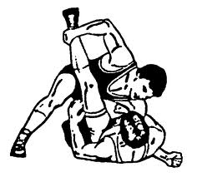
The Spirit of MI
vs.
  Partnership
  Acceptance
  Compassion
  Evocation
  Pressure
  Authority
  Confrontation
  Education
✔

Slide 19

The Spirit of MI
Guiding
Following
Directing

Slide 20
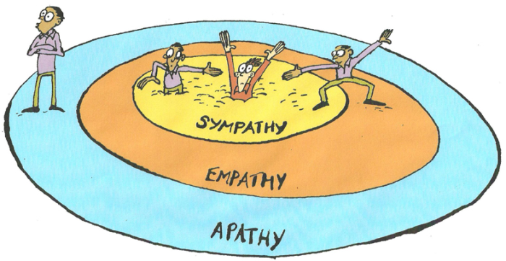
The Spirit of MI

Slide 21
How does MI work?
Client’s speech is met by empathic and strategic responses by the therapist
This influences what the client says next
As the interaction progresses, the client hears themself say out loud a solution to their problem

Slide 22
Four processes
Planning- step by step
Evoking- hope, confidence, commitment
Focusing-Identifying a target of change
Engaging- Settling into a helpful conversation
→
Notes:
Its possible to reframe those themes broadly into 4 processes that occur during a course of treatment. They are somewhat linear, in that higher level processes necessarily require the lower level ones, but they are also recursive, in the sense that you may realize that there’s a disruption to the relationship and that you need to re-engage someone.
Give an example.

Slide 23

A Taste of Motivational Interviewing
Notes:
23

Slide 24

The Technical Skills
  Open questions
  Affirmations
  Reflections
  Summaries
Notes:
Image used under creative commons share-alike licence, credit to Dave Bezaire and Suzie Havens-Bezaire, http://farm7.staticflickr.com/6232/6227927367_8ba954e24a_b.jpg (accessed on 12 Mar 2014)

Slide 25
Open Questions
Cannot easily be answered ‘yes’, ‘no’ or with a single word response, so contribute to moving the conversation.
Can dramatically steer the direction of the conversation
Explore depth rather than detail

Slide 26
Affirmations
A genuine* positive reflection of a person’s strengths, efforts, values, identities, or aspirations
Deeper than compliments
They function to stabilize the relationship
Preliminary evidence that they can bring out change talk (if people are going to make a difficult change, they need to know their strengths)
Notes:
Quote by Jeff and Kylie at the MINT

Slide 27
Reflections
A strategic guess about what the speaker means said out loud by the listener as a statement
Statements which gently steer and move the conversation forward towards change.
Reflections are the most frequently uttered phrases by MI practitioners (proficient practitioners typically make 2:1 reflections to questions)

Slide 28
Reflections
Simple
Convey understanding
Complex
Add substantial meaning or emphasis to what a person said
Parroting
Paraphrasing
Getting the gist
Reflecting both sides
Undershooting/overshooting for effect
Reflecting emotions
Reflecting values, identities

Slide 29
Summaries
Like checking the map to see where you have just been, and where you’re going next
Or like a bouquet of flowers you give back to the client of the most important things they’ve said

Slide 30

Change Rulers
Importance, Confidence, Readiness
Exercise:

Slide 31
What is something you have been thinking about doing, but haven’t started yet?
Apply readiness ruler to your potential change:
How important is it to you to make this change?
How confident are you that you can make this change?
How ready are you to make this change?
Notes:
31
Get everyone standing up at one end of the room.
Then ask them to imagine some change you have been wanting to make in your life but haven’t yet (refer to exercise at beginning of MI)
Move to where they represent their number and then demo bad MI and good MI questions to ask “Why are you a x and not a x-1?” “What might move you from an x to a x+1?”
Now have each person find a person or two nearby, and ask them the same questions:
What number are you at?
31

Slide 32

Readiness Ruler
A tool for eliciting change talk
How important is it to change this behaviour?
How confident are you that you could make this change?
How ready are you to make this change?
0 1 2 3 4 5 6 7 8 9 10
0 1 2 3 4 5 6 7 8 9 10
0 1 2 3 4 5 6 7 8 9 10
Notes:
32
Once the client has set their goal of quitting smoking, ask them to rate themselves using the readiness ruler that captures the importance, their confidence and how ready they are to change.
Follow up by asking:
Why did they choose the number they did? Why not a number higher (or lower)?
What would it take for them to want to move the scale up in importance, or confidence, or readiness?

Slide 33
Follow-up Questions
Why are you at (current score) and not zero?
What would it take for you to get from (current score) to (higher score)?
What has made this change this important to you so far, as opposed to it being unimportant (zero)?
What would it take to make this change even more important to you?”

Slide 34
What can you focus on if importance is low?
What can you focus on if confidence is low?
What can you focus on if readiness is low?

Slide 35
What can you focus on if importance is low?
  VALUES
What can you focus on if confidence is low?
  STRENGTHS
  SUPPORTS
What can you focus on if readiness is low?
  BARRIERS
  SUPPORTS

Slide 36
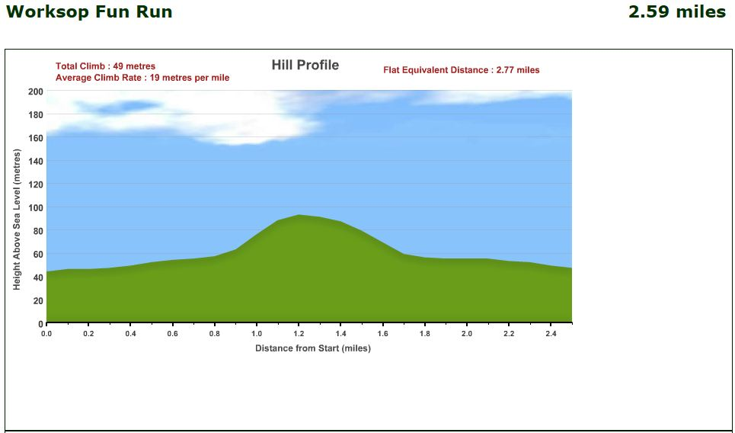
A Theory of “Change Talk”
MI therapist’s role
Preparatory change talk
Mobilizing change talk
Desire
Ability
Reasons
Need
Activation (Willingness)
Commitment
Taking Steps
Status quo
Change
Notes:
MI has done process research to understand what is happening in therapy. They have studied client and therapist language in sessions and used that to establish whether there was anything in what people said that influenced outcomes with drinking. They categorized different factors, the reasons, desire, need, and abilty to change. None of those on their own predicted change.
What happened, was that if there was a progression of those into Commitment Talk, “I will”, “I am going to”, and that was strengthened, then it was possible to develop a plan together, and that WAS predictive of change.
So guiding the conversation to allow commitment talk to emerge from change talk is critical. Though, there should be some caution that prematurely getting someone to commit does not lead to a meaningful commitment because the commitment was not intrinsic. So the progression is the key.

Slide 37
Preparatory Change Talk
Desire “I want to”
Ability “I’m able to”
Reasons “If I did… then…”; “because…”
Need “I have to…”
Notes:
want to change
• need to change
• should change
• have been thinking about changing but you haven’t
changed yet

Slide 38
Mobilizing Change Talk
Commitment “I will…”, “I am going to…”,
Activation “I’m willing to, “I’m ready”
Taking Steps “I have started to…”
Notes:
Commitment:
Activation: Implies a commitment without stating it, “almost there”.
Taking steps: something someone has done already in the direction of making a change. Again, doesn’t always imply commitment. Ie. Going to AA doesn’t mean that someone has committed to stop drinking.

Slide 39

A Theory of “Change Talk”
MI therapist’s role
Preparatory change talk
Mobilizing change talk
Desire
Ability
Reasons
Need
Commitment
Activation
Taking Steps
Status quo
Change
Notes:
MI has done process research to understand what is happening in therapy. They have studied client and therapist language in sessions and used that to establish whether there was anything in what people said that influenced outcomes with drinking. They categorized different factors, the reasons, desire, need, and abilty to change. None of those on their own predicted change.
What happened, was that if there was a progression of those into Commitment Talk, “I will”, “I am going to”, and that was strengthened, then it was possible to develop a plan together, and that WAS predictive of change.
So guiding the conversation to allow commitment talk to emerge from change talk is critical. Though, there should be some caution that prematurely getting someone to commit does not lead to a meaningful commitment because the commitment was not intrinsic. So the progression is the key.

Slide 40
Informing Strategies
Providing Information to our clients

Slide 41
Exercise: “The Expert”
Find a partner
One person takes the role of speaker/ “Expert”
The other person takes the role of the “Listener”
Instructions for the Experts:
Pick a hobby, sport, or any topic you are passionate about and feel you have some expertise
You have 2 minutes to tell your partner everything you think s/he needs to know and should know to become an “expert” on your chosen topic

Slide 42

Listeners:
What were you thinking or feeling during this conversation?

Slide 43
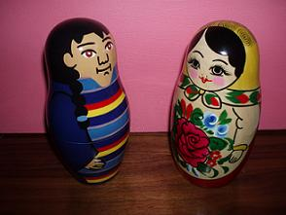
Providing Information…
in a motivational way…
Notes:
Expert to expert- this should feel like a conversation between 2 equals

Slide 44
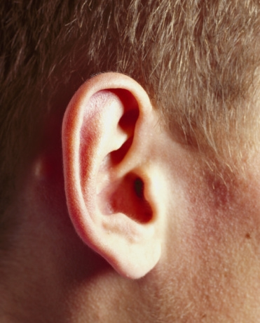

Elicit – Provide – Elicit
Notes:
ASK (elicit) – TELL (provide) – ASK (elicit)
Cyclical process of guided information exchange
Involves asking series open questions & listening
Draw from the client what they need, want to know, and what it means to them
Collaborative mindset
1) Elicit:
“what would you like to know about X” / “what do you already know about X”
Purposes: can save you time repeating what they already know, correct misconceptions, and can act as a form change talk since the client is at least implicitly stating the consequence for current health behaviour or a need for health behaviour change
2) Provide:
Information in a manageable chunk. Elicit stage should have allowed the client to ask a question provided an opening for the permission to inform, eg. “would you like me to tell you a bit about…”
3) Elicit:
Ask an open question in response to the information you just provided, eg. “what more would you like to know?”

Slide 45
  E-P-E
  Elicit the patient’s understanding of the problem
  Provide information
  Elicit patient’s response to your information
Notes:
45
ROLE PLAY – ask two people from the audience to come up and role play

Slide 46
For the Psychiatrist
Use OARS
  Open-ended questions, Affirmations, Reflections, Summaries
  Guide the interview
  Show Empathy
  Elicit Change Talk
Use EPE when giving feedback
  Ask for permission (implied or explicit)
  Elicit – Provide – Elicit
Use to prepare patient for structured therapy
  What things are most important in their life - how does their problem fit with these values/goals

Slide 47
Eight Tasks in Learning MI
Proficiency in client centered therapy, empathy
Eliciting and strengthening change talk
Rolling with resistance
Openness to collaborate with clients’ own experiences
Recognition of change talk
Negotiating change plans
Consolidating client commitment
Switching flexibly between MI and other styles
Notes:
Take home message:
openness to collaboration with clients’ own expertise,
people possess substantial personal expertise and wisdom regarding themselves and tend to develop in a positive direction if given proper conditions of support.
this spirit is less a precondition than a result of practicing MI.
If clients are viewed as having deficits (ie, being in denial, having poor insight, etc), it doesn’t make sense eliciting their wisdom, so it doesn’t happen.
proficiency in client-centered counseling, including accurate empathy,
Not simply repeating, but reflecting what they are experiencing but may not have said yet.
OARS (open questions, affirming, reflecting, summarizing)
recognition of key aspects of client speech that guide the practice of MI
desire,
ability,
reasons,
need,
or commitment to change
Commitment is the only one which predicts actual change. However, others are important because they predicted the emergence of commitment
eliciting and strengthening client change talk,
In ways that lower resistance: “In what ways might change be good?” vs “why haven’t you changed?”
rolling with resistance,
For example: If client says “Well, I overdo it sometimes, but I don’t have a problem with drinking.”
Simple reflection: You don’t think of yourself as a problem drinker.
Amplified reflection: Your drinking has never really caused any problems or unpleasant effects in your life.
Double-sided reflection: You think you drink too much at times, and also you don’t think of yourself as a problem drinker.
negotiating change plans,
offer a transitional summary of change talk (desire, ability, reasons, need)
Ask “what’s next?”
be curious about how the client envisions change happening, and what unique contributions the client can make to that change. Skill is developing a change plan without evoking resistence.
When asked or given permission, counsellor offers expertise.
consolidating client commitment, and
Don’t undermine change by pushing for it too early.
Again, requires close listening to language.
switching flexibly between MI and other intervention styles.
Synergistic effect when MI added to other programs
However, it can be frustrating or counter-therapeutic for a client who is ready for change to meet with a counselor whose focus is on contemplating change
When MI is done successfully, an initially ambivalent client advances in motivational readiness, develops a change plan, and commits to it. At this point, if treatment is to continue, the counselor would normally shift to a style that facilitates action
Could these be adapted to form the basis of the evaluation/needs assessment?

Slide 48
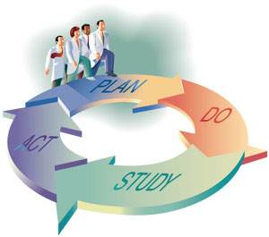
Quality Improvement
MI Treatment Integrity

Slide 49
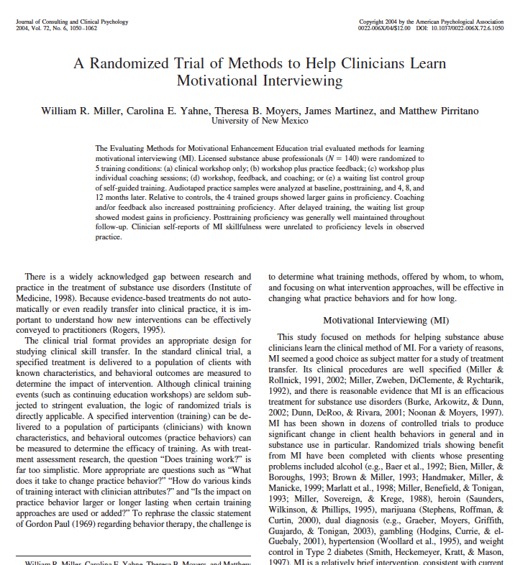
Notes:
This might be cut out if there is no time.

Slide 50
  140 substance abuse professionals
Baseline
Manual+
Tapes
Manual+
Tapes
Manual+
Tapes
Manual+
Tapes
Manual+
Tapes
Legend
W=2 day Workshop
F= individualized feedback on tape samples
C= Six telephone coaching sessions
W
W
W
W
Post
training
F
F
C
C
4 month
F
F
W
F
8 month
F
F
F
F
F
C
C
12 month
F
F
F
F
F
Notes:
People leave training believing that they have gained proficiency, but practice tapes reveal only modest skill acquisition (M, 2001). This poses a problem for self-reporting. In this 2004 study, they were told that they would only begin learning the MI skills and they should be looking to clients’ responses. If there is change talk, this is a re-inforcement. If there is resistance, this is an indication that they should move to more consonance.
Self-training control group
Two day workshop + self training
Self-training, workshop, individualized feedback on tape samples
Self-training, workshop, six telephone coaching sessions, but no tape feedback
Everything including tape feedback and individualized telephone coaching.

Slide 51
Training Summary
Self-study alone doesn’t change practice
Workshop benefits are temporary
Self-assessments have no bearing on actual behavior
Supervision is critical
  Individual coaching or Tape feedback is needed to alter practitioner behavior
  The combination of all these training methods is needed to produce measurable impacts on client behavior.

Slide 52
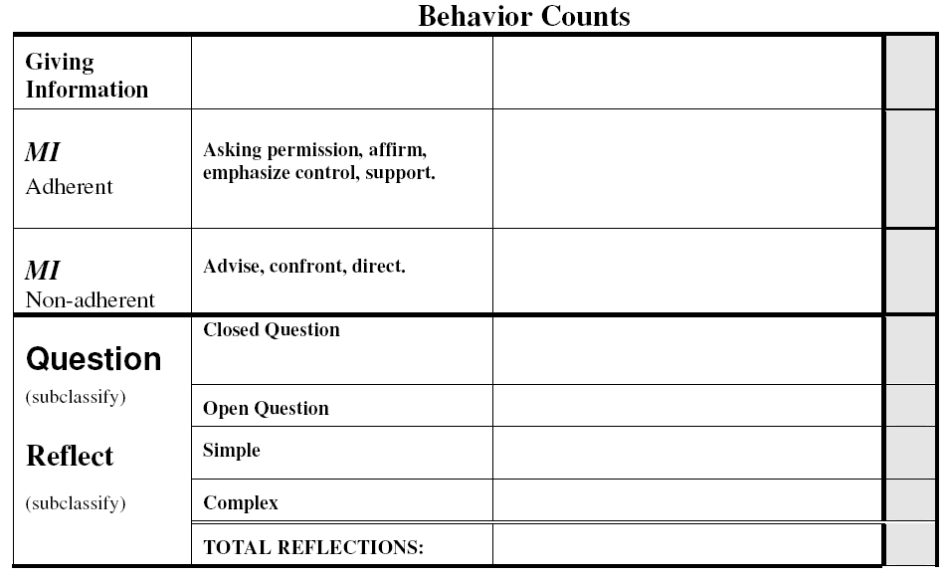
MI Treatment Integrity (MITI 3.1*)
* The most updated drafted version is version 4.2
Notes:
52
52

Slide 53
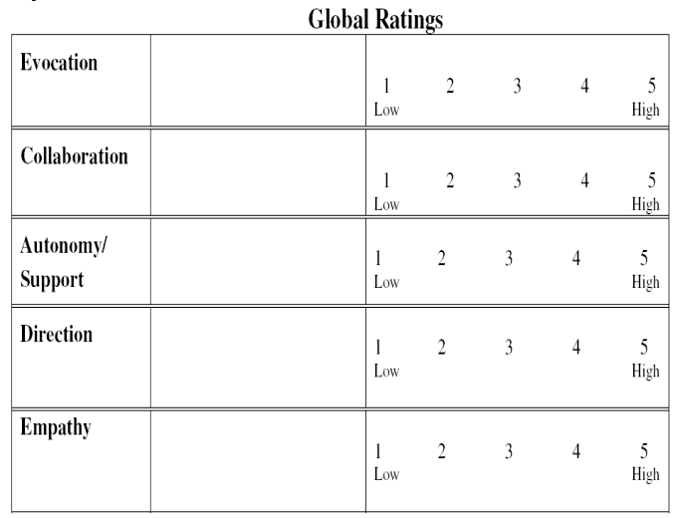
MI Treatment Integrity (MITI 3.1)
Notes:
53
53
53

Slide 54
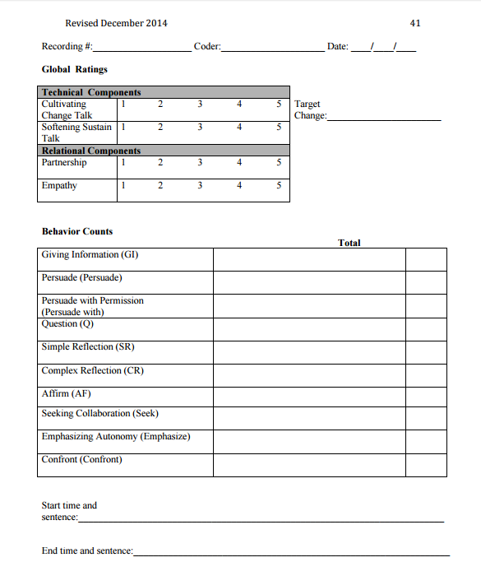
MITI 4.1

Slide 55
Take Home Messages
“a gentler and more productive conversation about change”
Spirit of MI - PACE
OARS
Change talk vs sustain talk
How do I bring MI into my practice?

Slide 56
Quiz
What are is the goal of Motivational interviewing?

Slide 57
Quiz
What are is the goal of Motivational interviewing?
  The patient to share “change talk”
  DARN CATS
    Desire
    Ability
    Reason
    Need

Slide 58
Quiz
What are the types of sentences the MI practitioner uses?

Slide 59
Quiz
What are the types of sentences the MI practitioner uses?
  OARS
    Open ended questions
    Affirmations
    Reflections
    summaries

Slide 60
Quiz
How do you get good at MI?

Slide 61
Quiz
How do you get good at MI?
  Feedback
    Coaching
    Recorded and scored sessions
    Deliberate practice

Slide 62
References
www.motivationalinterviewing.org
THANK YOU AND KEEP IN TOUCH
Wiplove.lamba@sinaihealth.ca

Slide 63
EXTRA

Slide 64
Strategies for Evoking Change Talk
Ask Evocative Questions – usually open questions help elicit change talk
Explore Decisional Balance – pros and cons of status quo and making changes.
Ask for Elaboration/Examples: When a change talk emerges, ask for more details: “In what ways?”; “Tell me more”; “When was the last time that happened?”

Slide 65
Strategies for Evoking Change Talk
Looking back: ask about a time when things were different/better
Looking forward: ask what may happen if things continue as they are or the miracle question, eg: “in 2 years, if you were 100% successful making changes you want, what would be different?”
Query extremes: “What are the worst things that might happen if you don’t make this change?”; “What are the best things that might happen If you do make this change?”

Slide 66
Strategies for Evoking Change Talk
3 Change rulers: Importance, confidence, readiness
Explore values and strengths
Come Alongside: side with reasons to maintain status quo

Slide 67
Exercise 4: One thing I like about myself
Speaker: “One thing I like about myself is [insert quality]”
Listener: Make a guess about what the person means and say it back to the person as a statement.
Speaker responds, YES, NO, or MAYBE.
Speaker repeats (1.) with the same quality.
Listener states a different guess to evoke a different response from the speaker.

